Slide 1

AutoGuard AI Predictive Vehicle Care with Security & Explainability
By Rushikesh and Shruti
Presented by Rushikesh and Shruti

Slide 2
Problem Statement
Problem: Unexpected car breakdowns result in lost time, irate customers, and unanticipated expenses.
Opportunity: Use root-cause insights to feed manufacturing, auto-schedule services, and anticipate failures early.
Solution in one line: Telematics, driver behavior, and UEBA are all combined in this master-agent orchestrated system to provide automated scheduling and explainable alerts.

Slide 3
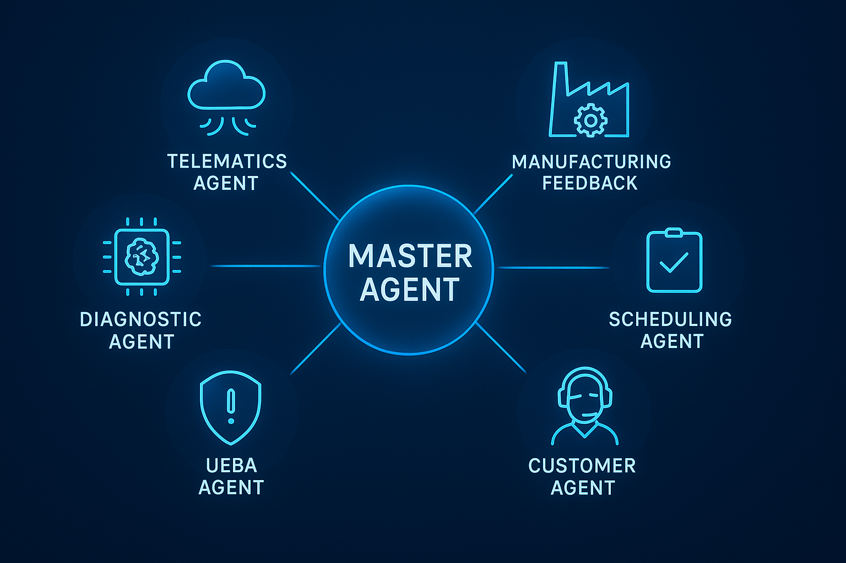
System Architecture & Agent Roles
Master Agent: orchestrates tasks and composes final recommendations.
Telematics Agent: streams and combines sensor data.
Driver Behavior Agent: extracts harsh braking and acceleration events and driving style features.
Diagnosis Agent: predicts likely component failures using a model and rule engine.
Scheduling Agent: matches service slots based on nearest, cheapest, or earliest availability.
UEBA Monitor: observes agent actions and flags unusual API calls or unauthorized workflows.
Manufacturing Insights: collects root cause analysis patterns and suggests design fixes.

Slide 4
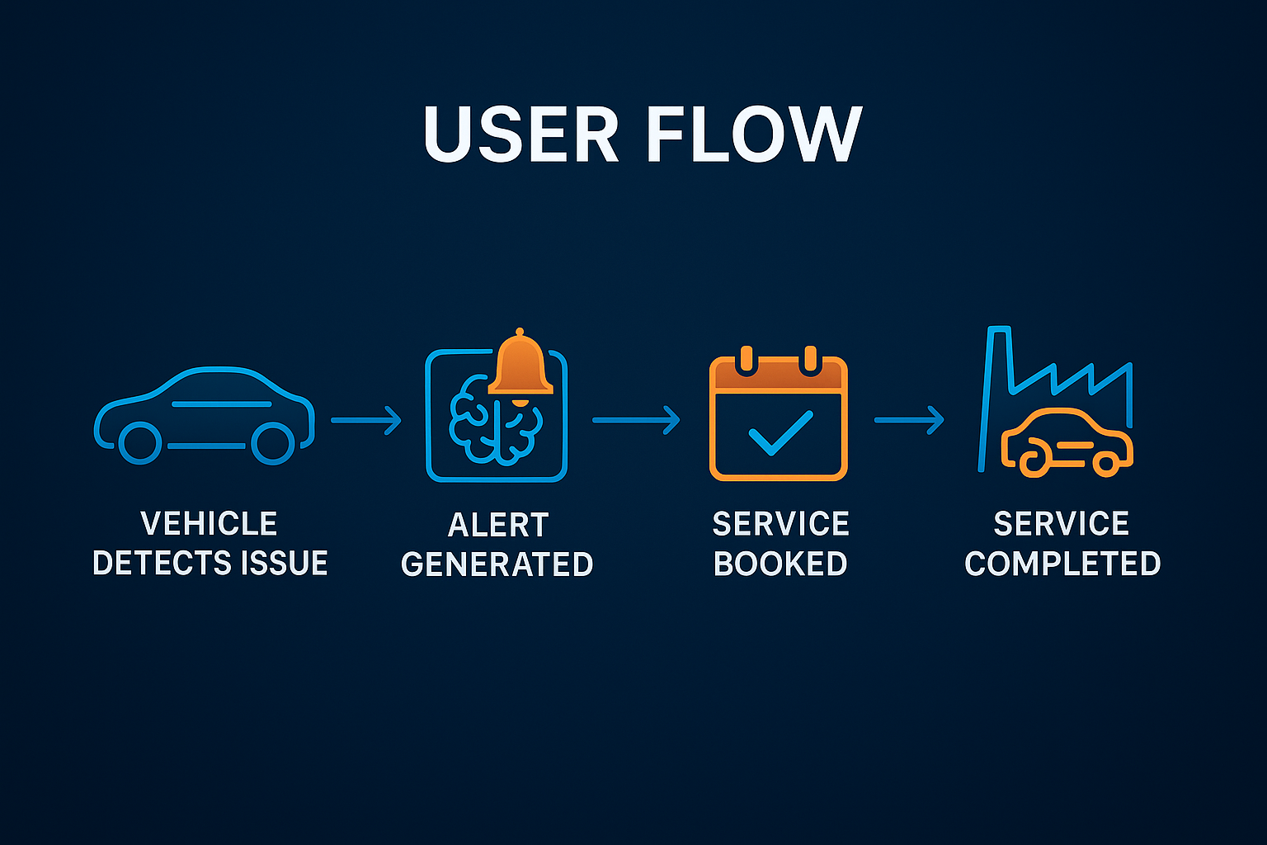
User Flow
Flow timeline
Vehicle reports rising engine temp + 5 harsh-brake events in 48h
Diagnosis Agent predicts brake failure risk = 78% in 7 days
Customer Agent proposes two slots; user approves
Scheduling Agent books quick slot; confirmation sent
Post-service feedback logged; manufacturing receives aggregated RCA.
Counterfactual
Top Risk Driver
Low oil level
High harsh brake count
Elevated vibration reading
What Could Be Different
Reducing harsh braking by 50% would lower the failure risk to 41%. A brake check during your next service could help prevent issues.

Slide 5
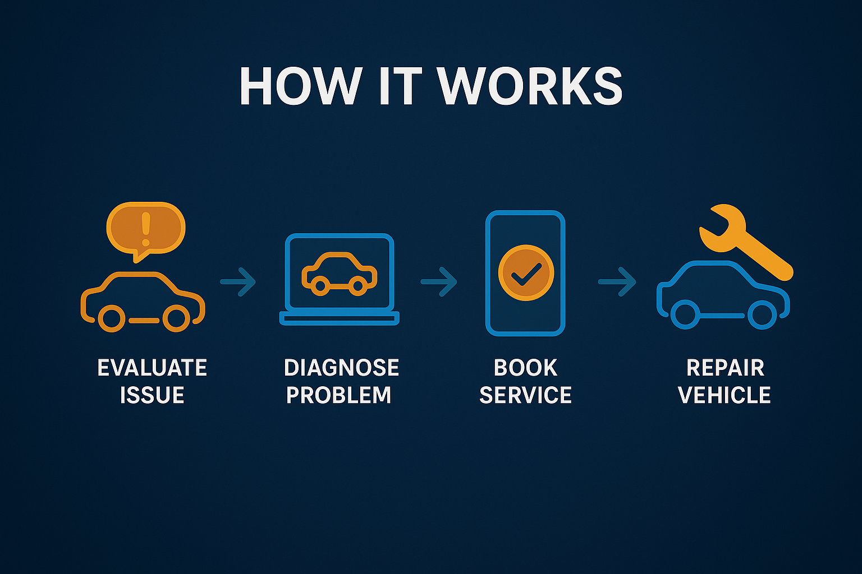
Prototype Vision
Concepts
Dashboard: Fleet health summary with alerts
Alert modal: Prediction card with SHAP explanation + two booking options (OEM/Local) + counterfactual sentence.
UEBA Log: One line showing flagged rogue action and auto-block.
Build Plan
Simulate telematics and driver data
Build basic UI(Dashboard and alert mode
Mock service booking and UEBA simulation

Slide 6
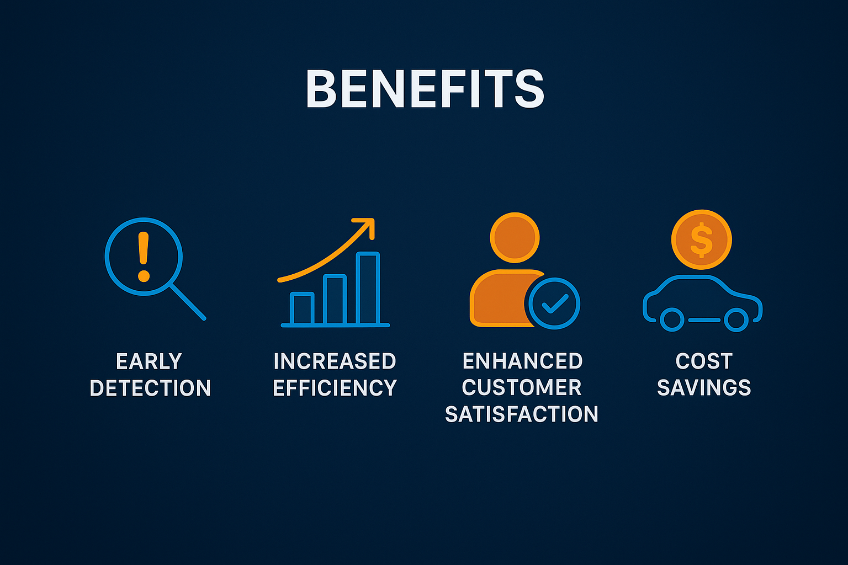
Impact, KPIs & Next Steps
Impact
Unplanned breakdowns decrease by 30 – 45%
False alerts decrease by 25 – 35%
Fleet uptime increase by 15 – 25%
Time to booking reduced to < 5 minutes
UEBA prevented 100% of simulated rogue action is demo
AutoGuard AI — Keep vehicles moving, safely and intelligently.

Slide 7
Thank You

